Slide 1
Databricks CICD with Jenkins, git,AWS
Nilakantha Singh Deo
KPI Partners, India

Slide 2
Step:2Install Databricks-cli on windows
To install run : pip install databricks-cli
To upgrade run : pip install databricks-cli --upgrade
Keep the following things in handy before configuring databricks locally:
Databricks host: should look like https://dbc-xxxxxxxx-xxxx.cloud.databricks.com
AccessToken :should look like: dxxxxxxxxxxxxxxxxxxxxxxxxxxxxxxxxx01
Clusterid :should look like: 0513-xxxxxx-xxxxxxxx
Setup authentication using : databricks configure --token

Slide 3
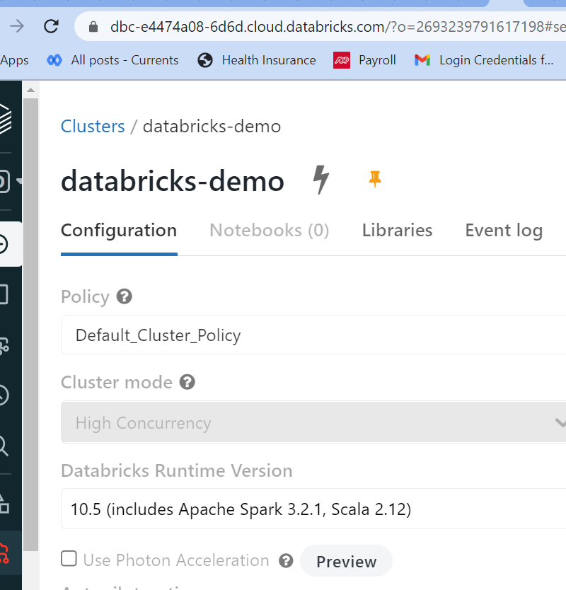
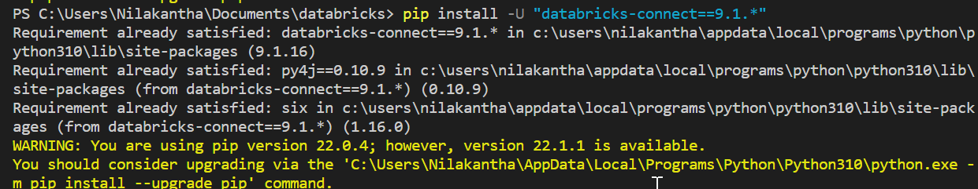
Step:2Install pyspark on local machine inside vscode ide
Step 1: Install the client
Uninstall PySpark. This is required because the databricks-connect package conflicts with PySpark. For details, see Conflicting PySpark installations.
pip uninstall pyspark
pip uninstall databricks-connect
pip install -U "databricks-connect==9.1.*" # or X.Y.* to match your cluster version
Check version in the Databricks>>

Slide 4
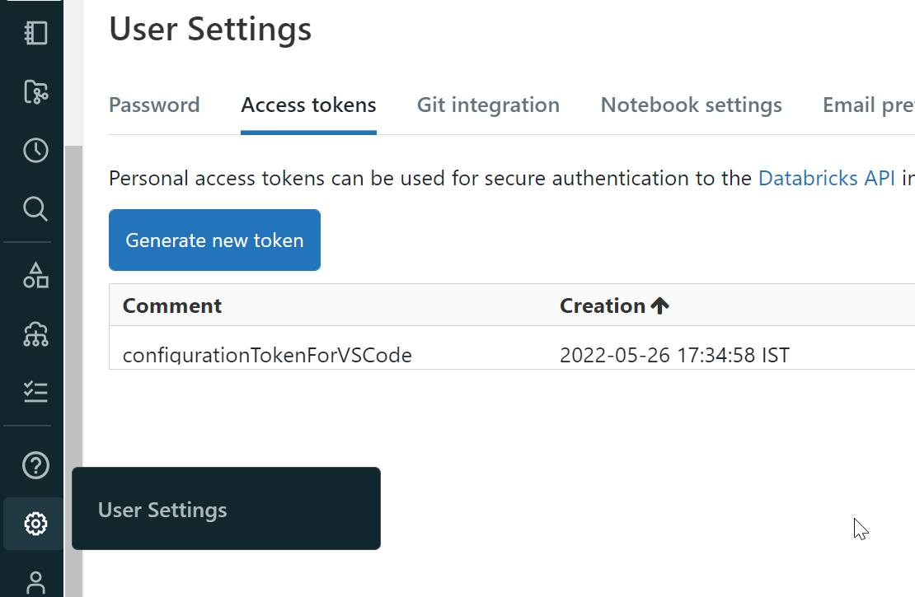
Step 3: Configure connection properties
Get all the details of the workspace from Databricks
To find cluster id ,orgid etc check the link below
https://<databricks-instance>/#/setting/clusters/<cluster-id>
Example : if my link in Databricks is https://dbc-e4474a08-6d6d.cloud.databricks.com/?o=26932xxxxxxxxx8
then :
Databricks host: https://dbc-exxxxxx8-xxxx.cloud.databricks.com
Port:
Clusterid: dbc-exxxxxx8-xxxx
Access token>>>
OrgId: 26932xxxxxxxxx8
And run the following command
databricks-connect configure

Slide 5
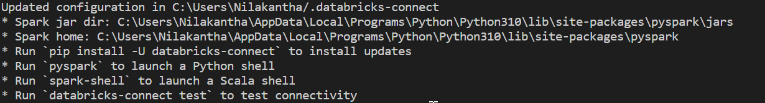
Install other supportive tools
pip install pytest
pip install databricks-cli
pip install databricks-connect
pip install requests
databricks-conntect test

Slide 6
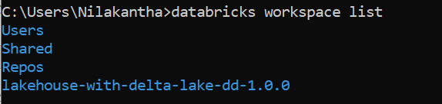
Test databricks cli
Run the following command
databricks workspace list
It should return the workspace list if any .

Slide 7
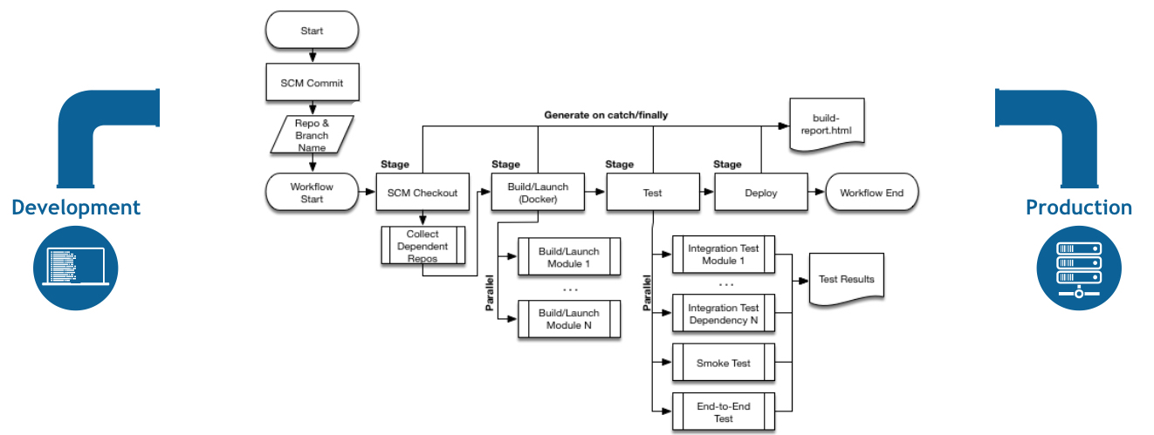
Pipeline concept

Slide 8
Pipeline syntax
Pipeline syntax overview
The following Pipeline code skeletons illustrate the fundamental differences between Declarative Pipeline syntax and Scripted Pipeline syntax.
Be aware that both stages and steps (above) are common elements of both Declarative and Scripted Pipeline syntax.

Slide 9
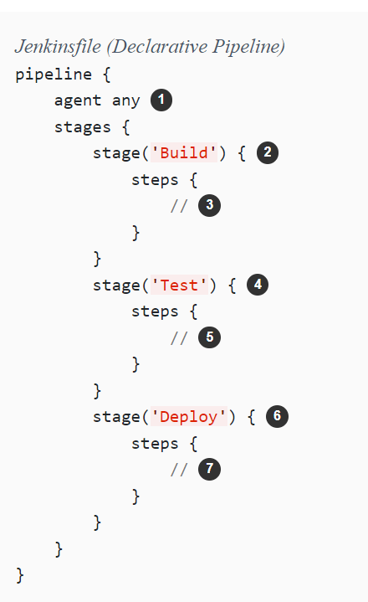
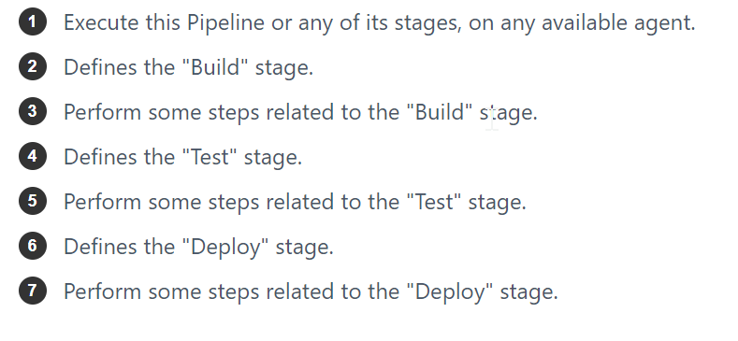
Declarative Pipeline fundamentals
In Declarative Pipeline syntax, the pipeline block defines all the work done throughout your entire Pipeline.

Slide 10
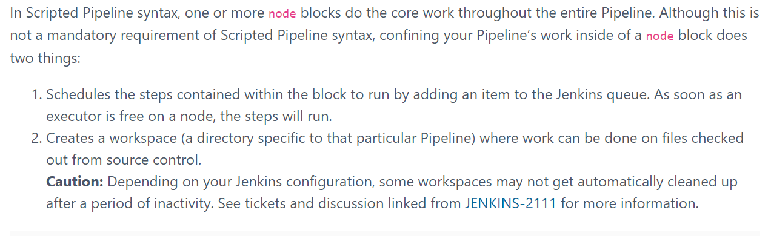
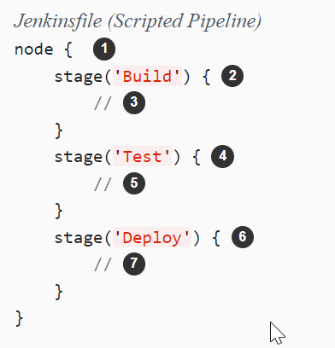
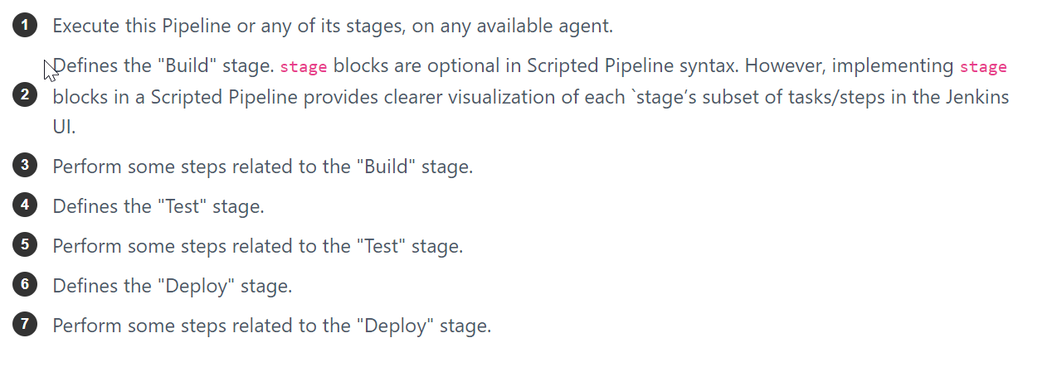
Scripted Pipeline fundamentals

Slide 11
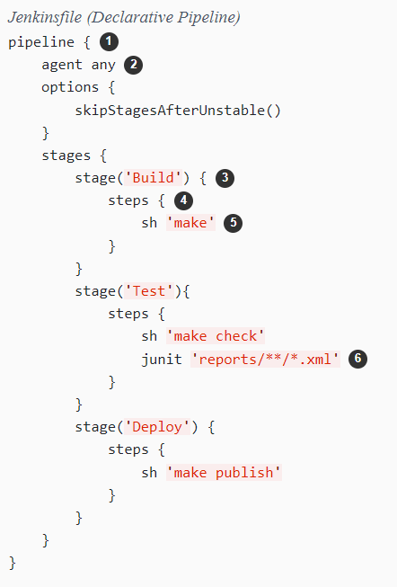
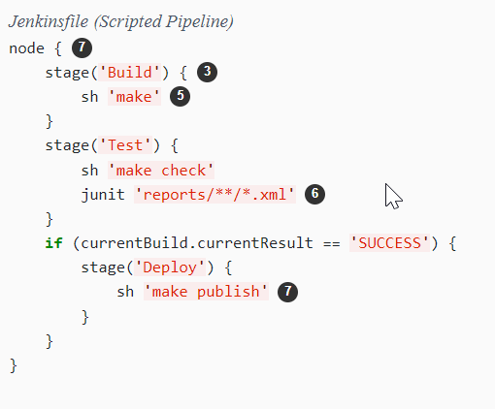
Example

